Slide 1
Visualizing Crime Statistics using Beeline CLI, HCatalog, and Pig
BY: MEGAN ESCOBAR
ALEXANDER BUGARIN
DAVID HA
ALEJANDRO CANO

Slide 2
Table of Contents
Objectives
Dataset
Beeline CLI
Excel
Pig
Notes:
MEGAN:

Slide 3
Objectives
Get data manually using HDFS commands
Perform analysis using HiveQL commands
Visualize the data in Microsoft Excel
Download
Process
Visualize
Notes:
MEGAN:
Objectives
In this hands-on lab, you will learn how to:
-Get data manually using HDFS commands
-Perform analysis using HiveQL commands
-Visualize the data in Microsoft Excel

Slide 4
Flowchart
Open shell through Git Bash
SSH to Hadoop Server Using IP Address
Download Files using wget Command
Use HDFS chmod to Make Beeline Work
Run Beeline
Create Tables
Process Further in Pig?
Visualize in Excel
SCP or PFSTP Files from HDFS
No
Query Tables
Yes
Store Data in HDFS
Load and Filter Data
Open Grunt Interface
Notes:
ALEJANDRO:

Slide 5
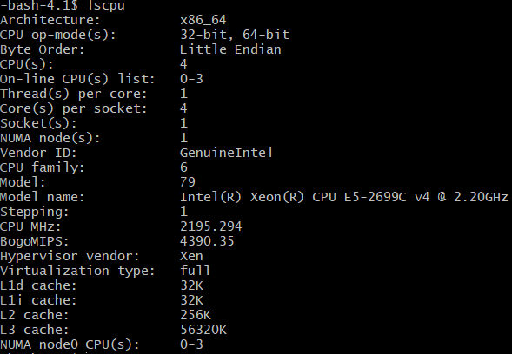
Platform Spec
IBM Bluemix BigInsights
CPU Speed: 2195.294 Mhz
# of CPU cores: 4
# of nodes: 5
Total Memory Size: 150 GB
Notes:
DAVID:

Slide 6
Crimes – 2001 to Present
The dataset “Crimes – 2001 to present” is extracted from the Chicago Police Department's CLEAR (Citizen Law Enforcement Analysis and Reporting) system.
The data reflects incidents of crime that have occurred in Chicago from 2001 to the present, with the exception of the last seven days.
This data can be accessed at the following website:
https://data.cityofchicago.org/Public-Safety/Crimes-2001-to-present/ijzp-q8t2/data
Notes:
MEGAN: Some disclaimers: because this dataset is continuously updated, the results from completing the lab will be different than the results of the lab tutorial. Furthermore, the dataset contains more than 65,000 records/rows of data and cannot be viewed in full in Microsoft Excel. The website recommends that when downloading the data select CSV from the Export menu and open the file in an ASCII text editor, such as Wordpad, to view and search.

Slide 7
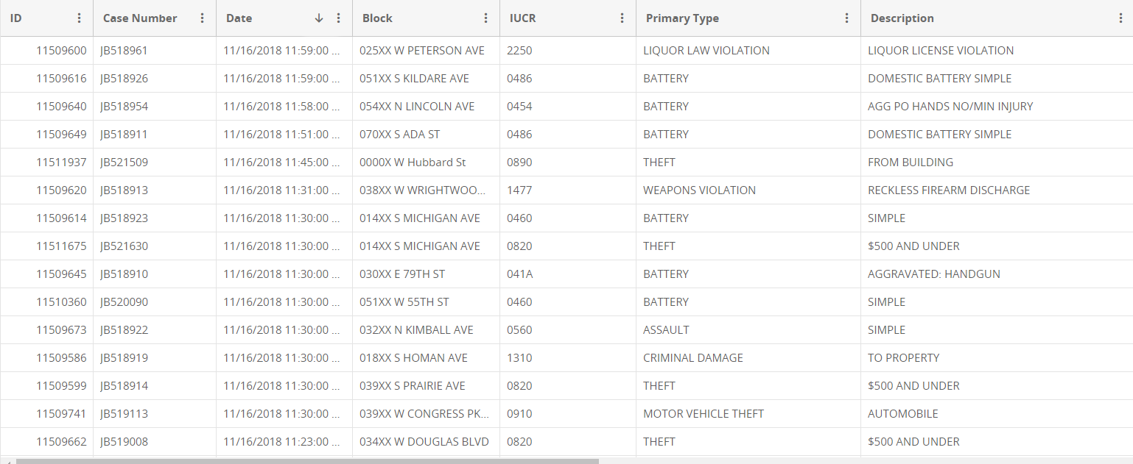
Data Fields
The dataset contains 22 fields which organize the crimes by ID, case number, date, crime reporting codes, type of crime, etc.
Notes:
MEGAN: When you view the dataset on the Chicago Data Portal website, you can see that some of the information that the dataset contains is its identifying number, the case ID, the date the crime was reported, the block it was committed on, and its primary type. The values under the block column represent the street the crime was committed on, rather than an address for the sake of the victim’s privacy.
The column IUCR also corresponds to the Illinois Uniform Crime Reporting (IUCR) codes.

Slide 8
Downloading the Data
To download the comma separated data from the website use the following:
-bash-4.1$ wget -O crime_data https://data.cityofchicago.org/api/views/ijzp-q8t2/rows.csv?accessType=DOWNLOAD
Notes:
MEGAN: This is the actual link to export the CSV file.
After downloading the data, use the command –mkdir to make the directory “chicago_crime” and use the command –put
Following these commands you would use the command rm to remove the file crime_data from the local server to conserve space.

Slide 9
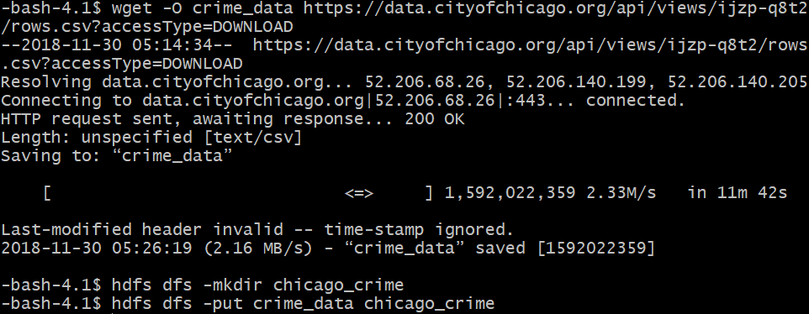
Downloading the Data
hdfs dfs -chmod -R o+w .
Notes:
MEGAN: This is the actual link to export the CSV file.
After downloading the data, use the command –mkdir to make the directory “chicago_crime” and use the command –put
Following these commands you would use the command rm to remove the file crime_data from the local server to conserve space.
The command –chmod changes the permissions of files. With -R, the change is made recursively through the directory structure.

Slide 10
Beeline CLI
Access the Beeline CLI environment
Create a table to contain the data
CREATE EXTERNAL TABLE IF NOT EXISTS crimes(ID STRING, …)
ROW FORMAT DELIMITED FIELDS TERMINATED BY ','
LOCATION '/user/mescob33/chicago_crime' TBLPROPERTIES
('skip.header.line.count'='2');
Notes:
DAVID: We use “ROW FORMAT DELIMITED FIELDS TERMINATED BY ‘,’” because the file in HDFS is a comma separated values file.
We use LOCATION to provide the path of the file of what we will populate the table with.
And “'skip.header.line.count'='2'” to begin populating the table on the third line of the file because the file has different column headers and lines.

Slide 11
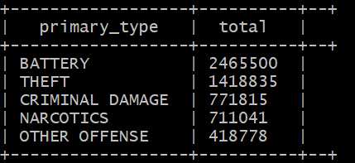
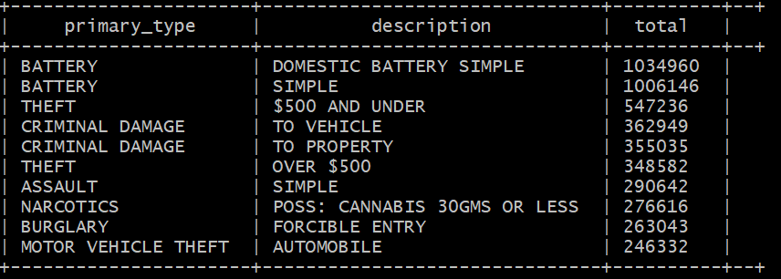
Query Results
SELECT primary_type, COUNT(primary_type) as total from crimes GROUP BY primary_type ORDER BY total DESC limit 5;
SELECT primary_type, description, COUNT(description) as total from crimes GROUP BY primary_type, description ORDER BY total DESC limit 10;
Notes:
DAVID: We can analyze the data in several ways such as on which blocks the most crimes occur, which crimes are the most committed, how often arrests occur, etc. To do so, we can create queries in Hive to return specified records.
First Query: To determine which type of crime is committed the most we can use the following query:
Second Query: Each primary type has an accompanying description which describes in detail the level of the crimes such as if the theft is under $500, aggravated, if a weapon is involved, etc. As you can see the total number of the type of crime is comprised of different degrees to the crime such as theft over $500 dollars and theft under $500.

Slide 12
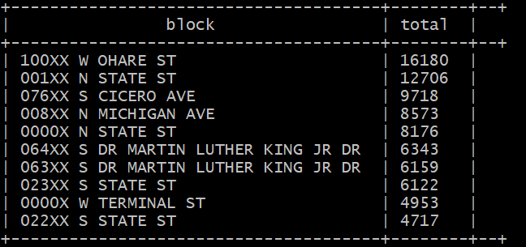
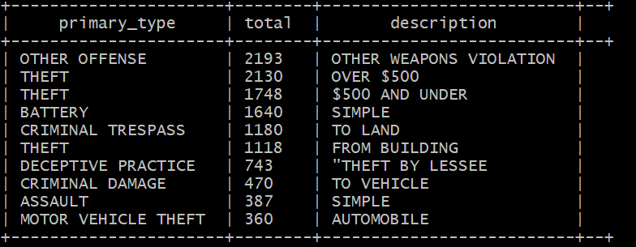
Query Results
SELECT block, COUNT(block) as total from crimes GROUP BY block ORDER BY total DESC limit 10;
SELECT primary_type, COUNT (primary_type) AS total, description from crimes WHERE block == '100XX W OHARE ST' GROUP BY primary_type, description ORDER BY total DESC limit 10;
Notes:
DAVID: We can also analyze which areas are the most prone to crime.
First Query: This gives us a rough estimate on which street has the most crime. Based on the query, “100XX W OHARE ST” has the highest frequency of crime occurrence.
Second Query: Analyzing further, we can see what crimes are being committed in this area. From this query, we can determine that the most common crime on 100xx W OHARE ST is weapons violation followed by theft.

Slide 13
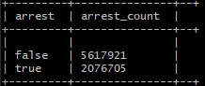
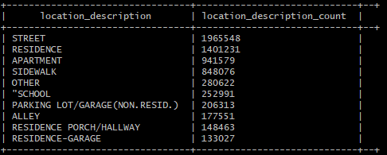
Query Results
SELECT arrest, COUNT(arrest) as (arrest_count) from crimes GROUP BY arrest;
SELECT location_description, COUNT(location_description) as Location_Description_Count from crimes GROUP BY location_description ORDER BY location_description_count DESC limit 10;
Notes:
DAVID: We can also find the arrest ratio.
First Query: From this query, we can see that about 30% of all incidents involve the criminal being arrested.
Second Query: We can also find the location where crime tends to happen the most at. As shown, the top three location where crime occur is at “Street”, “Residence”, and “Apartment”.

Slide 14
Battery Table
To focus on the primary_type “BATTERY,” create a table from the base table crimes.
CREATE TABLE IF NOT EXISTS battery_occurence ROW FORMAT DELIMITED FIELDS TERMINATED BY ',' AS select * from crimes where primary_type = 'BATTERY';
The descriptions can range from simple, to domestic battery simple, to several variations of aggravated battery using different weapons. We want to further categorize these as mild if the description is simple, moderate if it is domestic battery simple, and severe if it is anything else.
Notes:
ALEX: We can visualize the data as well as process it further in Microsoft Excel. Excel enables us to create detailed maps of the data which can make it easier for us to compare differences in the severity of the crimes committed, the frequency at which they are committed, and even allows us to process the data in ways which we are limited in the Hive environment with HiveQL. For the following example, we will analyze and later visualize the different categories of the primary type battery. To do so we must make a table that contains only data for the records whose primary type is “BATTERY.”
After making the battery table, we want to create a new column to rank the battery based on its description. **Third bullet point on screen**

Slide 15
Severity Table
DROP TABLE IF EXISTS severity;
--create the severity table by selecting from the battery_occurence table
CREATE TABLE severity
ROW FORMAT DELIMITED FIELDS TERMINATED BY ','
STORED AS TEXTFILE LOCATION '/user/mescob33/chicago_crime/severity_table'
AS SELECT *, IF((description) == 'SIMPLE', 'Mild', IF((description) == 'DOMESTIC BATTERY SIMPLE', 'Moderate', 'Severe')) AS crime_severity
FROM battery_occurence;
Notes:
ALEX: To categorize the descriptions, we use a nested if column. The if statement passes three arguments IF(a>b, true, false). But because the description column contains more than three types of descriptions, we need to create a nested statement where the third option is a default if it does not meet the first two criteria.
We will also store this file in a new directory titled chicago_crime/severity_table

Slide 16
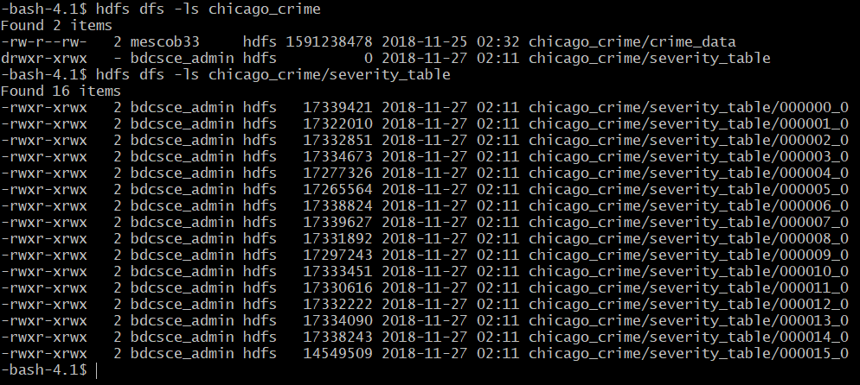
Downloading the Data
You can download one of the files in HDFS under the chicago_crime/severity_table directory
hdfs dfs -get /user/mescob33/chicago_crime/severity_table/000001_0
Notes:
ALEX: when you go back to your HDFS shell and perform the command –ls chicago_crime/severity_table you can see it contains several files that were written by several MapReducers. We will visualize one of them.
To do so, we must use the –get command to put the file in the local server so that we may download it using SCP or PFSTP

Slide 17
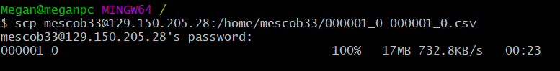
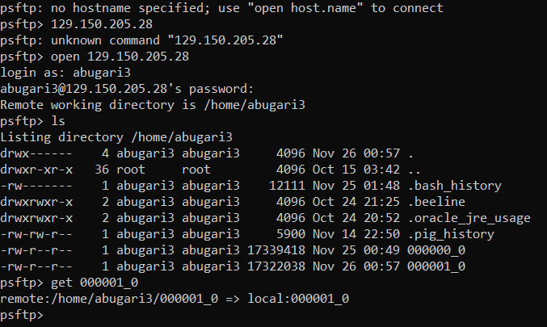
Downloading a File using PFSTP or SCP

Slide 18
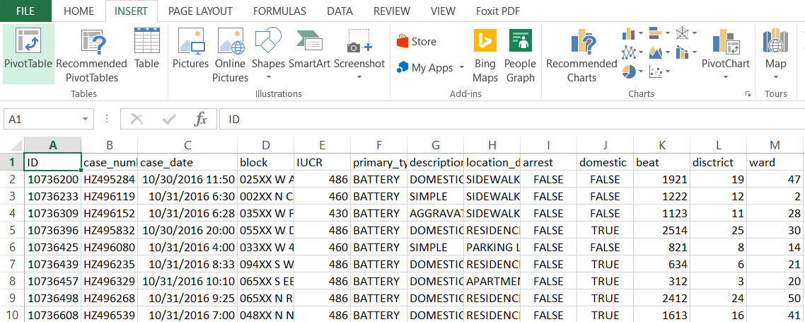
Excel
Notes:
ALEX: when you open the file you must add the corresponding column headers. You can then insert a 3D map.

Slide 19
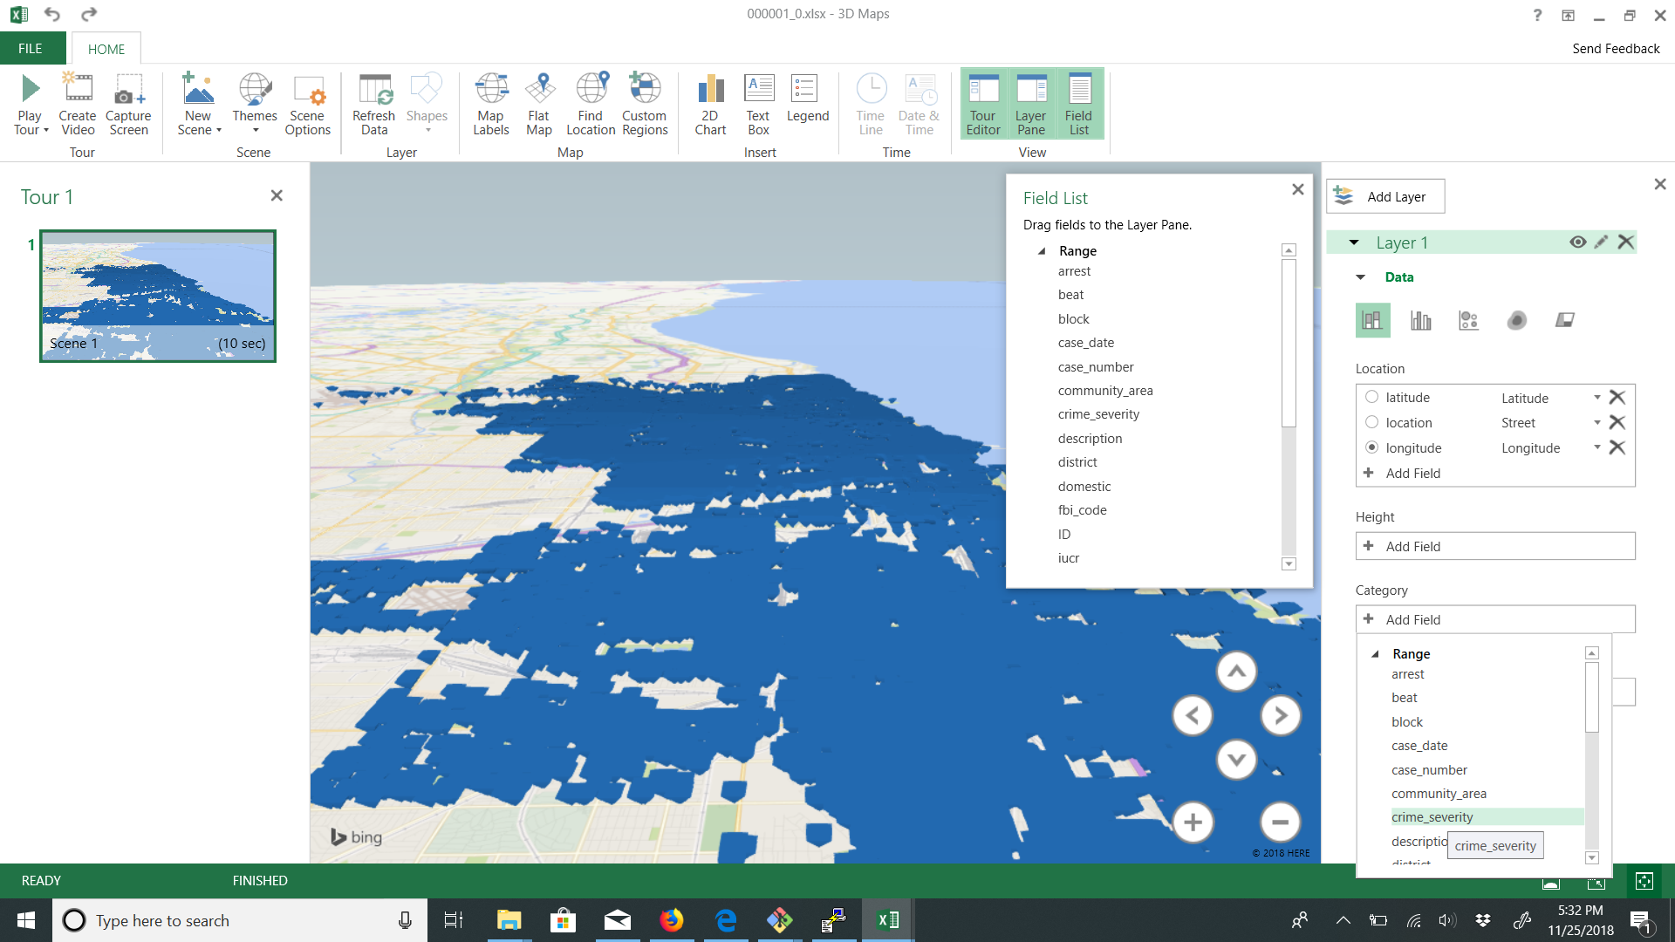
Excel
Notes:
ALEX: After opening a new tour, select either latitude or longitude for the location category. Then under category, select crime_severity

Slide 20
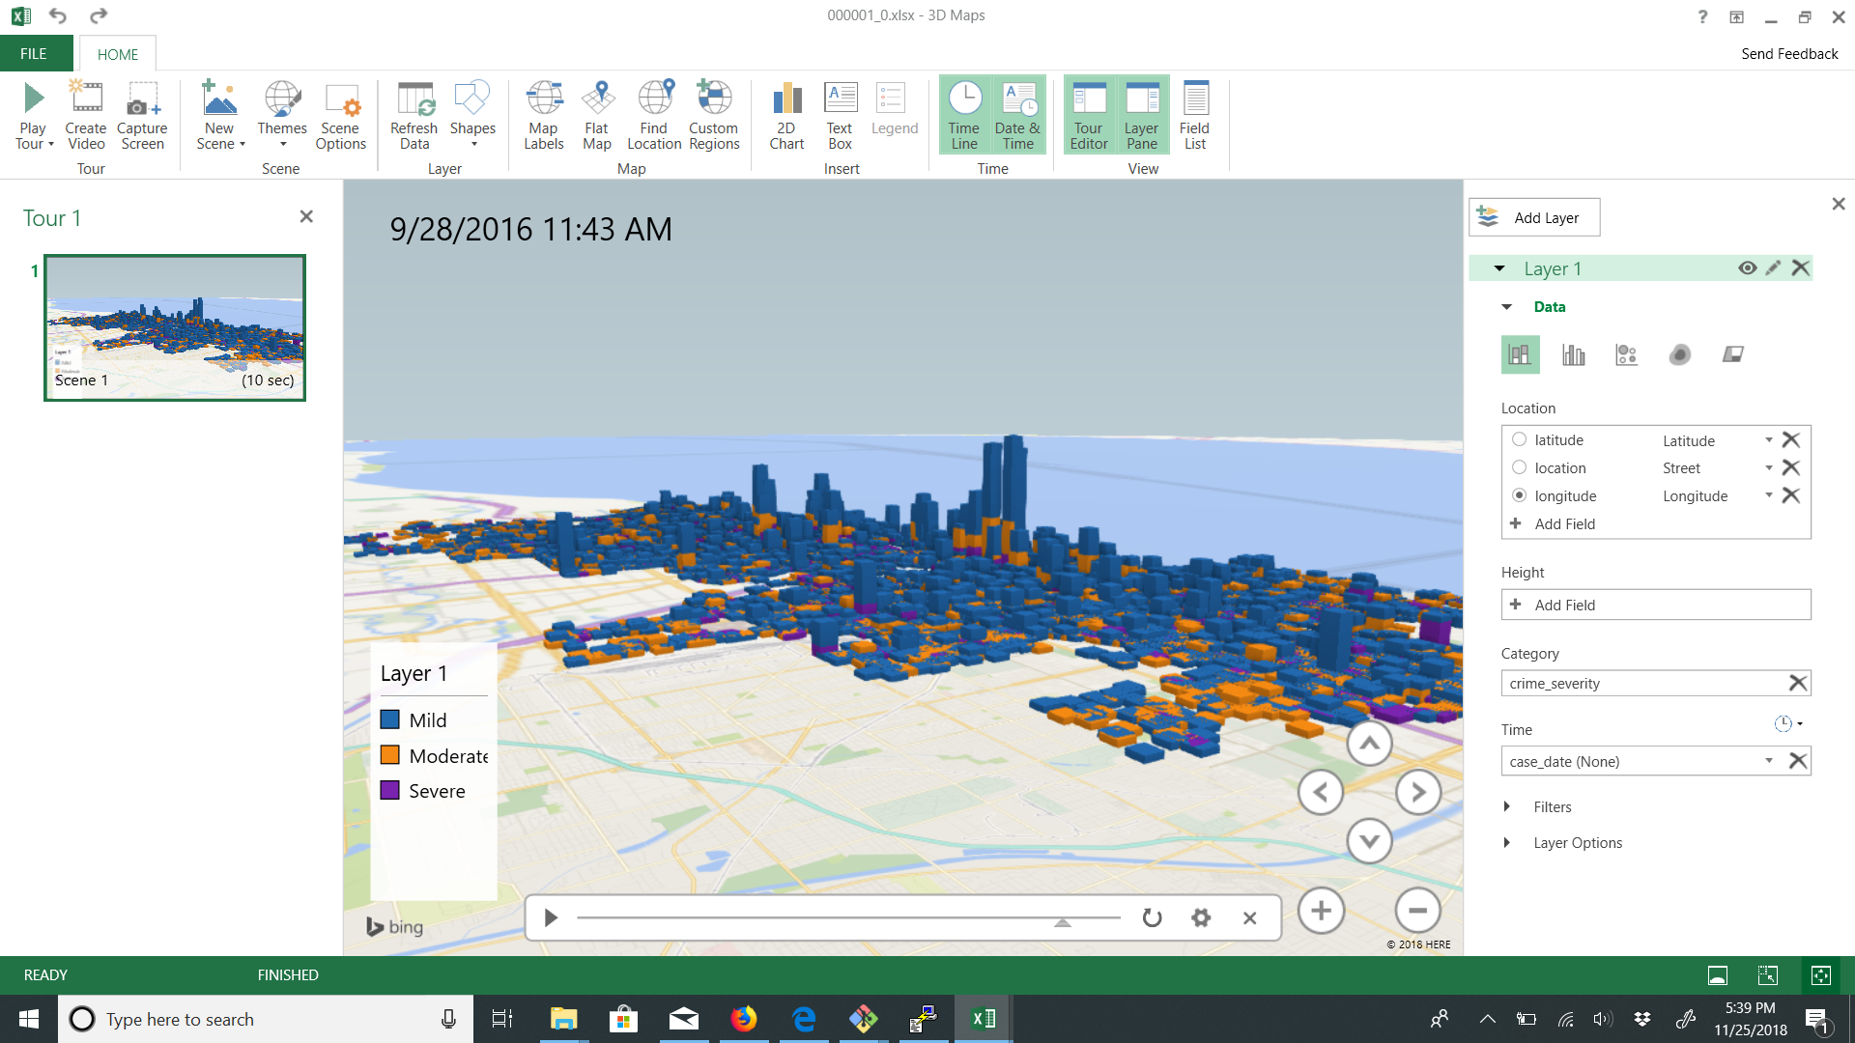
Excel
Notes:
ALEX: We can then also add a time dimension with the case_date category. Here we case see a massive spike in activity in between the years 2016 and 2018.

Slide 21
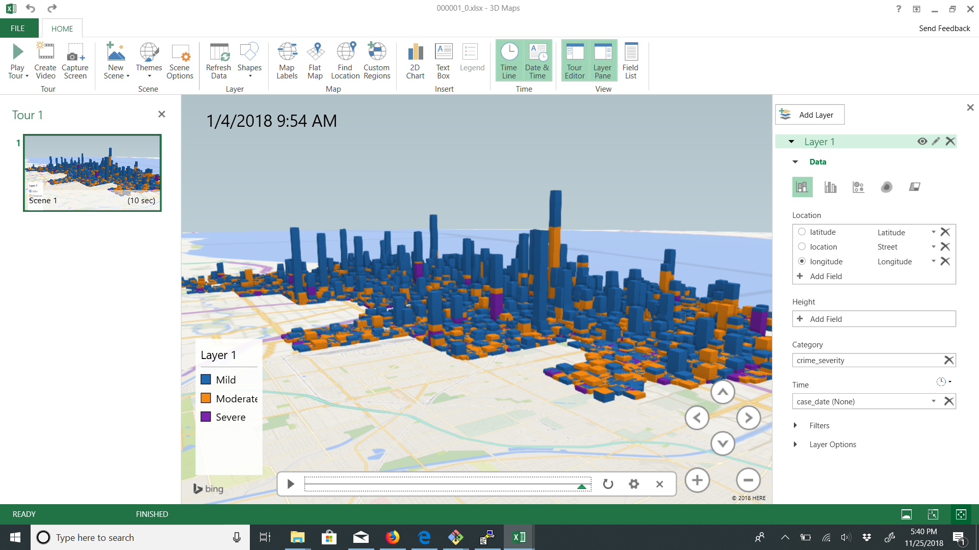
Excel

Slide 22
Data Processing in Excel
Note: The crime_data file includes column headers that can cause Excel to mistake it for a SYLK file when opening it as a CSV file. The problem arises from the first line of the file beginning with the word “ID.” If it were “id” or even “Id,” Excel would be able to open the file, however it is “ID.” For this reason we must remove the first line of the crime_data file and save it as a new file titled “new_crime.csv” in the local server. You may do this with the following command:
-bash-4.1$ sed '1d' crime_data > new_crime.csv
Notes:
ALEJANDRO: the sed command is a “stream editor.” We can use it to remove the first line of the crime_data file which contains the column headers. The command 1d will remove the first line and we will save this new file to a new csv file titled “new_crime.”

Slide 23
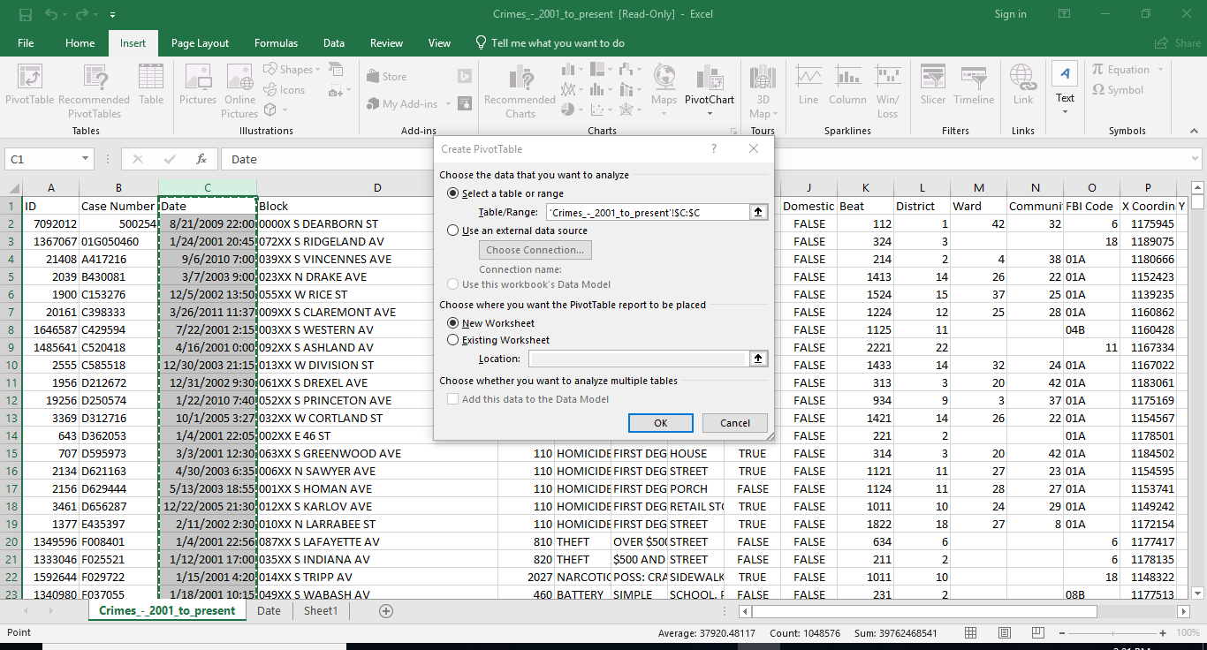
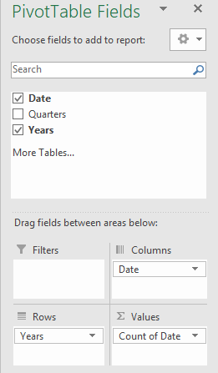
Data Processing in Excel
Notes:
ALEJANDRO: after downloading this file with SCP or PFSTP as previously show, we can now open the file in excel. We need to add the corresponding column headers once again before we are able to manipulate the data.
In this first pivot table, we can show how many crimes occur over the years per month. This operation would be very complex to do as the date column of the crimes table contains both the date and time of the crime. We would need to perform a string split on this column and use the MONTH and YEAR function on the two new columns to retrieve the correct information.
So to create the correct table we must drag the year field into the rows section, date into the columns section, and date into the summation values section.

Slide 24
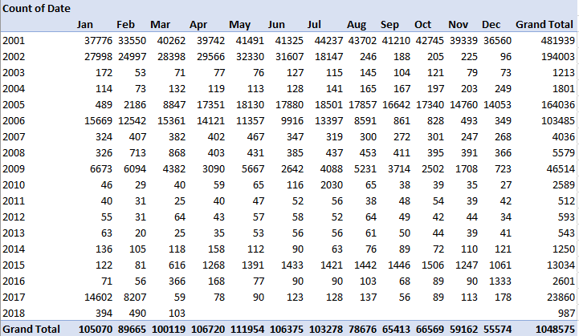
Occurrence of Crime
Notes:
ALEJANDRO: From this pivot table we can determine that the most crime occurred in 2001. We can also see that the most crime occurs within the month of May.

Slide 25
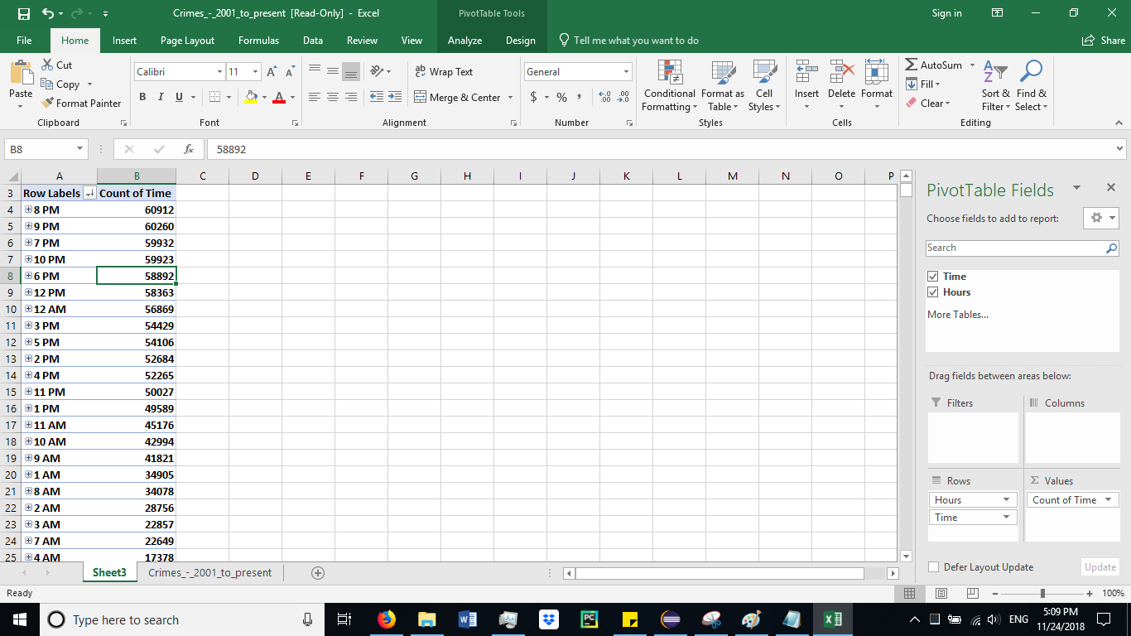
When Crime is Committed
Notes:
ALEJANDRO: Similarly, we can create a pivot table from the date and time column to determine which hour of day the most crime occurs.

Slide 26
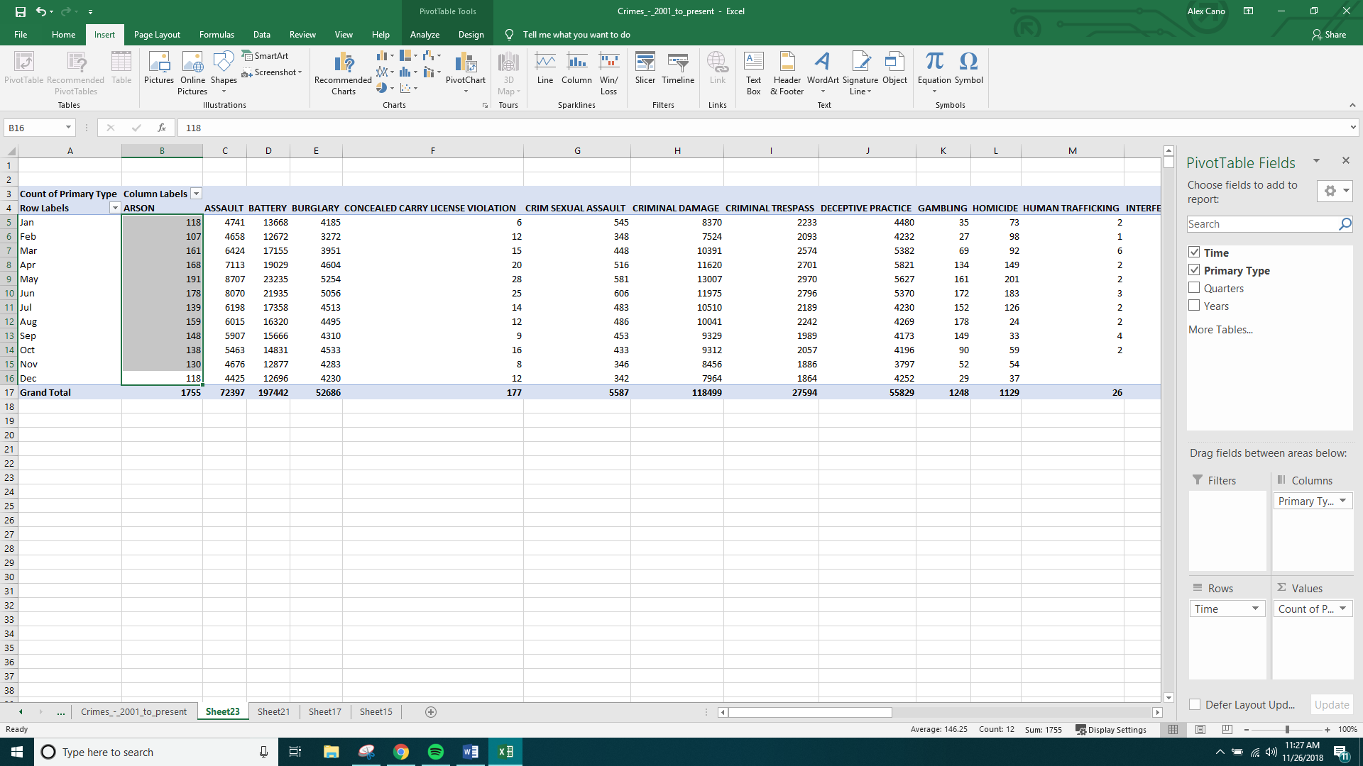
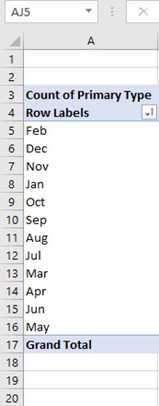
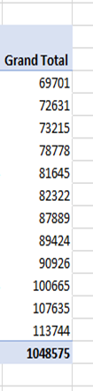
Occurrence of Crime
Notes:
ALEJANDRO: We can create a pivot table from multiple columns as well. In this example, we created one from the time and primary type columns.
For the column headers, drag the primary type field to the columns section. Drag the time field to the rows section, and the primary type to the values section.
To find the least/most crimes committed per month highlight the primary type column and sort and filter it to ascending. This shows that February is the month with the least committed crimes and shows once again that May has the most crimes committed.

Slide 27
Narcotics
After making another directory in HDFS named “narco” to contain your results, create a table which will consist of information regarding the primary type “narcotics.”
CREATE TABLE IF NOT EXISTS narcotics ROW FORMAT DELIMITED FIELDS TERMINATED BY ',' AS select id, block, primary_type, description, latitude, longitude, year, updated_on, case_date from crimes where primary_type = 'NARCOTICS';
Notes:
ALEX: We can analyze specific crimes and store the information in HDFS. In the following example we will create a more detailed table from the crimes table named “narcotics.” From this table we will use the Pig interface Grunt to filter the data by the description “POSS: CANNABIS 30MG OR LESS” and store this data in HDFS.

Slide 28
Pig
Open another terminal and open the Pig interface Grunt by typing in pig -useHCatalog in the terminal, which adopts Hcatalog to share Hive tables with Pig
data = LOAD 'mescob33.narcotics' using org.apache.hive.hcatalog.pig.HCatLoader();
narco = FILTER data BY description == 'POSS: CANNABIS 30GMS OR LESS';
limit_narco = LIMIT narco 50000;
Notes:
ALEX: to load hive data into pig you must export the data using HCatLoader(). You must then filter the data to only contain information where the description is “POSS: CANNABIS 30GMS OR LESS” and limit the results to 50,000 records.

Slide 29
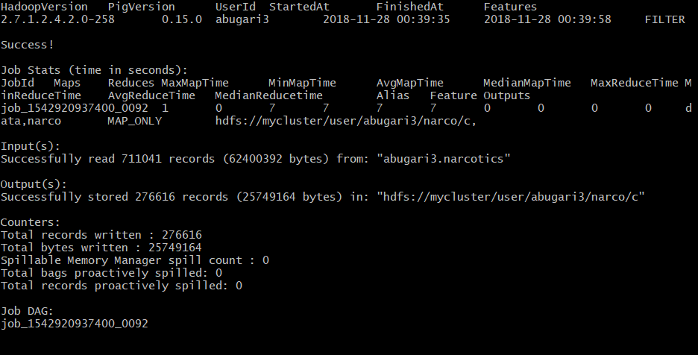
Pig
With the following command, you will store the output to a new file in HDFS under the directory you had previously created.
STORE narco INTO 'narco/c' USING PigStorage(',');
Notes:
ALEX: after downloading the file using PFSTP or SCP as previously demonstrated, open the file in Excel and add the column headers and add a 3D map.

Slide 30
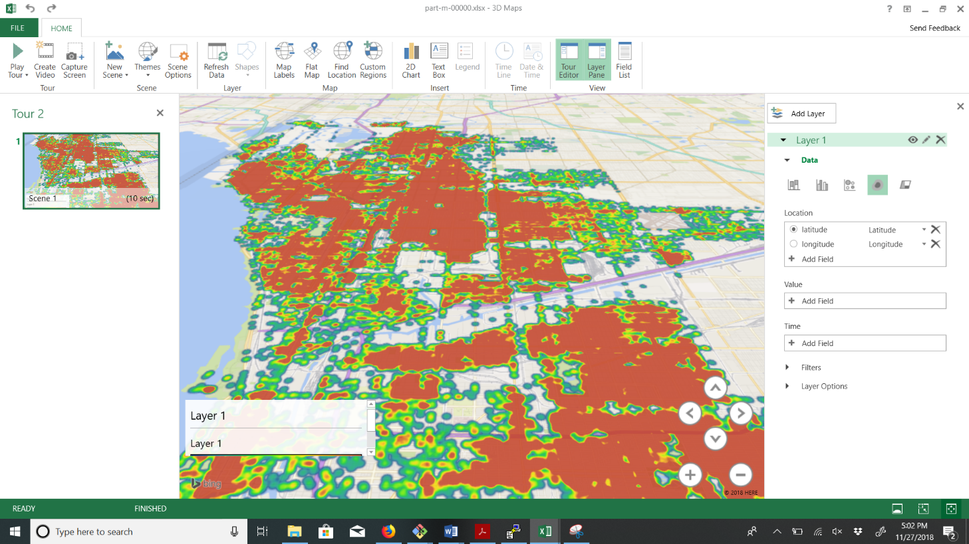
Pig
Notes:
ALEX: change the data type to a heatmap and here we get a detailed visualization of the activity regarding marijuana possession.

Slide 31
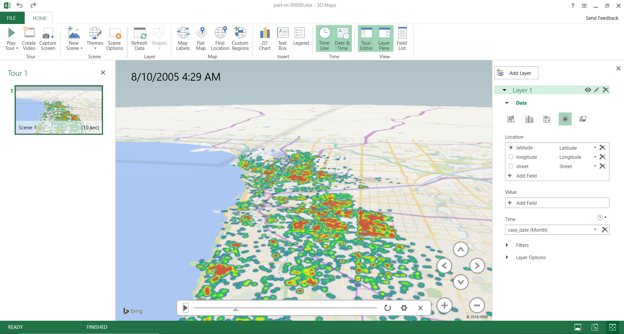
Excel
Notes:
Alex: Here we can see a timelapse of activities regarding narcotics activities.

Slide 32

Excel
Notes:
Alex: there are relatively very little change between the year 2005 and 2012

Slide 33
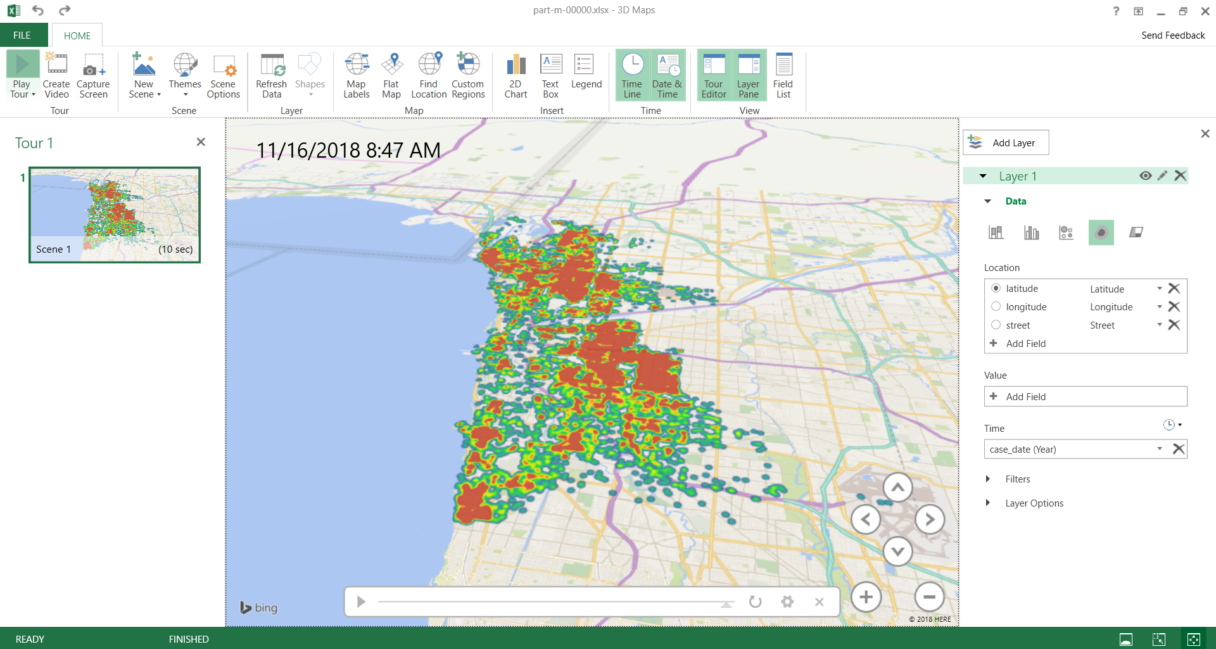
Excel
Notes:
Alex: when we get to the year 2016 to 2018 we see a much more visible increase in activity for whatever reason.

Slide 34
References
URL of Data Source website: https://data.cityofchicago.org/Public-Safety/Crimes-2001-to-present/ijzp-q8t2
URL of Data Source CSV file: https://data.cityofchicago.org/api/views/ijzp-q8t2/rows.csv?accessType=DOWNLOAD
GitHub: https://github.com/DayWait/BigData.git

Slide 35
END

